Slide 1

Introduction to Deep Learning
CYNTHIA CORREA
Notes:
The superstar of machine learning
Many slides come from Deep Learning, A visual introduction slides.
https://www.slideshare.net/LuMa921/deep-learning-a-visual-introduction

Slide 2
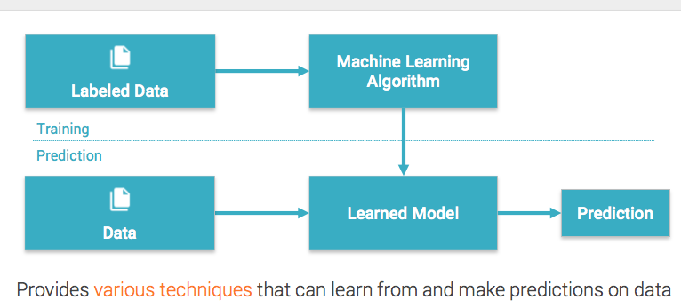
Machine Learning
Notes:
Three types:

Slide 3
Where we are
Data Science
Machine Learning
Deep
Learning
Deep Neural Networks

Slide 4
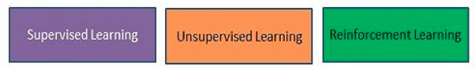
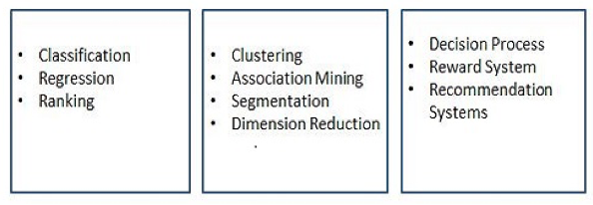
Three main types of Machine Learning
Notes:
Supervised: We provide the model some sample results, then the model tries to determine the results for cases where the answer is not known.
Unsupervised: The model determines parameters based on the data. We may provide details about the output that we want.
Reinforcement: Uses decision chains to take actions in an environment so as to maximize some notion of cumulative reward.
In machine learning, the environment is typically formulated as a Markov decision process (MDP), as many reinforcement learning algorithms for this context utilize dynamic programming techniques. correct input/output pairs are never presented, nor sub-optimal actions explicitly corrected. Further, there is a focus on on-line performance.
Categories are not exclusive (some ranking models use reinforcement learning, for instance)

Slide 5
Deep Learning
Set of techniques for learning in neural networks
The study of neural networks
Can be supervised or unsupervised

Slide 6
Deep Neural Networks
Algorithms that have one or more hidden layers
Exceptional at learning patterns
Non-”deep” neural networks can only be supervised. Example: Support Vector Machines

Slide 7
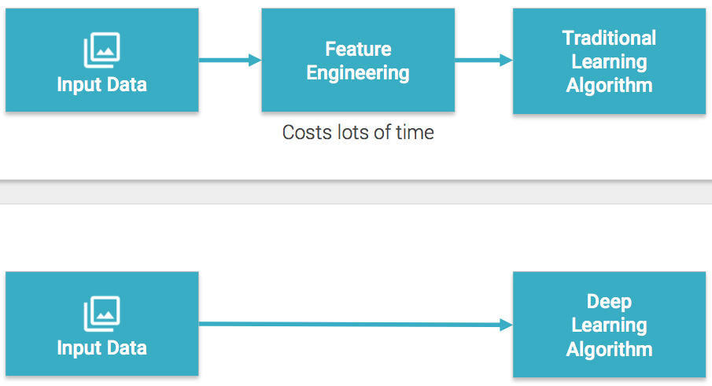
Feature engineering not needed

Slide 8
What is feature engineering?
Manually choosing input features
Benefits:
Reduce complexity and computation
Prevent over-fitting due to redundant features
Prevent curse of dimensionality for small datasets
Cons:
Costly
Requires domain knowledge
Difficult
Notes:
fully-connected hidden layers in- between. Each layer is represented as a series of neurons and progressively extracts higher and higher-level features of the input until the final layer essentially makes a decision about what the input shows. The more layers the network has, the higher- level features it will learn.

Slide 9
Deep Neural Networks
Train on new data
After a wrong classification, they can
recalculate the importance of a feature
Example: car make and model
Notes:
Where the “deep” part comes in, is that the system, as time goes on and it gains more experience, can increase its probability of a correct classification, by “training” itself on the new data it receives. In other words it can learn from its mistakes -just like us. For example it may incorrectly decide that a particular vehicle was a certain make and model, based on their similar size and engine noise, overlooking another differentiator which it determined had a low probability of being important to the decision. By learning that this differentiator is, in fact, vital to understanding the difference between two vehicles, it improves the probability of a correct outcome next time.

Slide 10
Strengths of Deep Neural Networks
Classifying based on combinations of features or units
Things that human brains do automatically

Slide 11
Strengths of Deep Neural Networks
Classifying based on combinations of features or units
Things that human brains do automatically

Slide 12
Examples
Image and speech recognition
Generating text
Translating languages
Spatial navigation
Playing games
Predicting court decisions
Precision medicine
Robotics

Slide 13
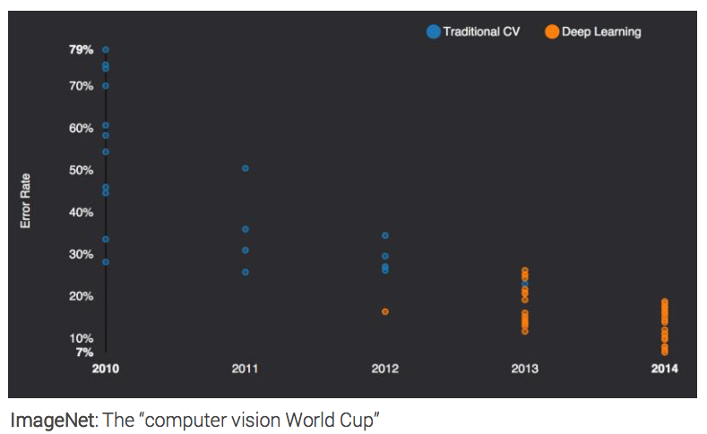
Blowing away the competition

Slide 14
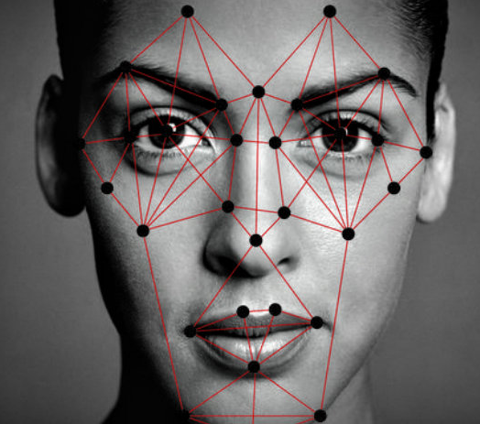
Facial Recognition – Applications?
Notes:
Supervised: We provide the model some sample results, then the model tries to determine the results for cases where the answer is not known.
Unsupervised: The model determines parameters based on the data. We may provide details about the output that we want.
Reinforcement: Uses decision chains to take actions in an environment so as to maximize some notion of cumulative reward.
In machine learning, the environment is typically formulated as a Markov decision process (MDP), as many reinforcement learning algorithms for this context utilize dynamic programming techniques. correct input/output pairs are never presented, nor sub-optimal actions explicitly corrected. Further, there is a focus on on-line performance.
Categories are not exclusive (some ranking models use reinforcement learning, for instance)

Slide 15
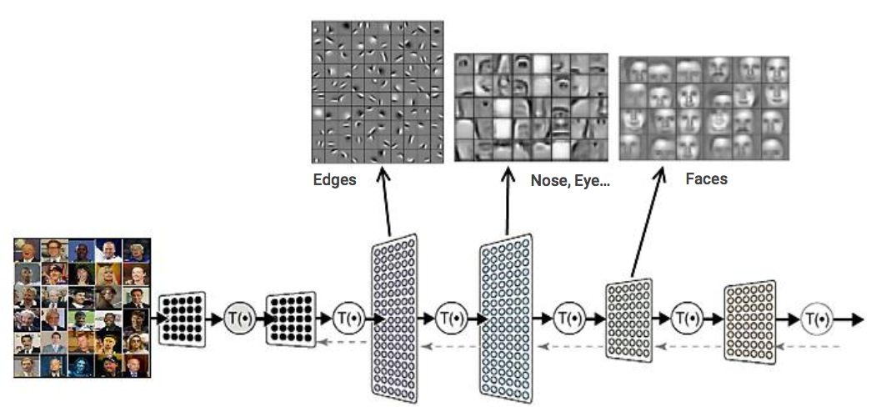
Deep Neural Networks
“Tom, Mike, Jim, etc, etc”
Hierarchy: Input layer Hidden Layers Output Layer
Notes:
Supervised: We provide the model some sample results, then the model tries to determine the results for cases where the answer is not known.
Unsupervised: The model determines parameters based on the data. We may provide details about the output that we want.
Reinforcement: Uses decision chains to take actions in an environment so as to maximize some notion of cumulative reward.
In machine learning, the environment is typically formulated as a Markov decision process (MDP), as many reinforcement learning algorithms for this context utilize dynamic programming techniques. correct input/output pairs are never presented, nor sub-optimal actions explicitly corrected. Further, there is a focus on on-line performance.
Categories are not exclusive (some ranking models use reinforcement learning, for instance)

Slide 16
Why care how it works?
Troubleshooting
Literature
Analytical Translation
Beat benchmarks
Understand
Stand out
Only have to do it once!
Notes:
Supervised: We provide the model some sample results, then the model tries to determine the results for cases where the answer is not known.
Unsupervised: The model determines parameters based on the data. We may provide details about the output that we want.
Reinforcement: Uses decision chains to take actions in an environment so as to maximize some notion of cumulative reward.
In machine learning, the environment is typically formulated as a Markov decision process (MDP), as many reinforcement learning algorithms for this context utilize dynamic programming techniques. correct input/output pairs are never presented, nor sub-optimal actions explicitly corrected. Further, there is a focus on on-line performance.
Categories are not exclusive (some ranking models use reinforcement learning, for instance)

Slide 17
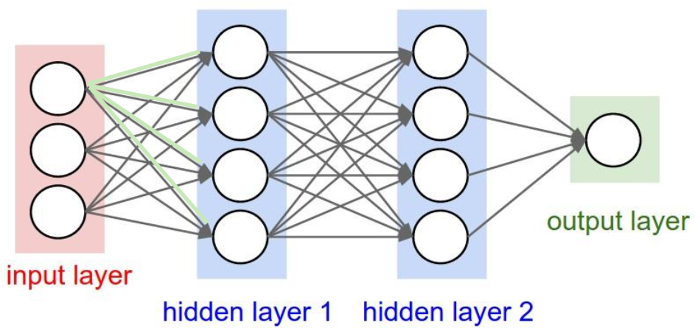
Neurons inform next layer neurons

Slide 18
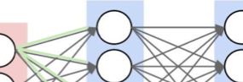
Each neuron filters and detects
“Tom, Mike, Jim, etc, etc”
Notes:
Supervised: We provide the model some sample results, then the model tries to determine the results for cases where the answer is not known.
Unsupervised: The model determines parameters based on the data. We may provide details about the output that we want.
Reinforcement: Uses decision chains to take actions in an environment so as to maximize some notion of cumulative reward.
In machine learning, the environment is typically formulated as a Markov decision process (MDP), as many reinforcement learning algorithms for this context utilize dynamic programming techniques. correct input/output pairs are never presented, nor sub-optimal actions explicitly corrected. Further, there is a focus on on-line performance.
Categories are not exclusive (some ranking models use reinforcement learning, for instance)

Slide 19
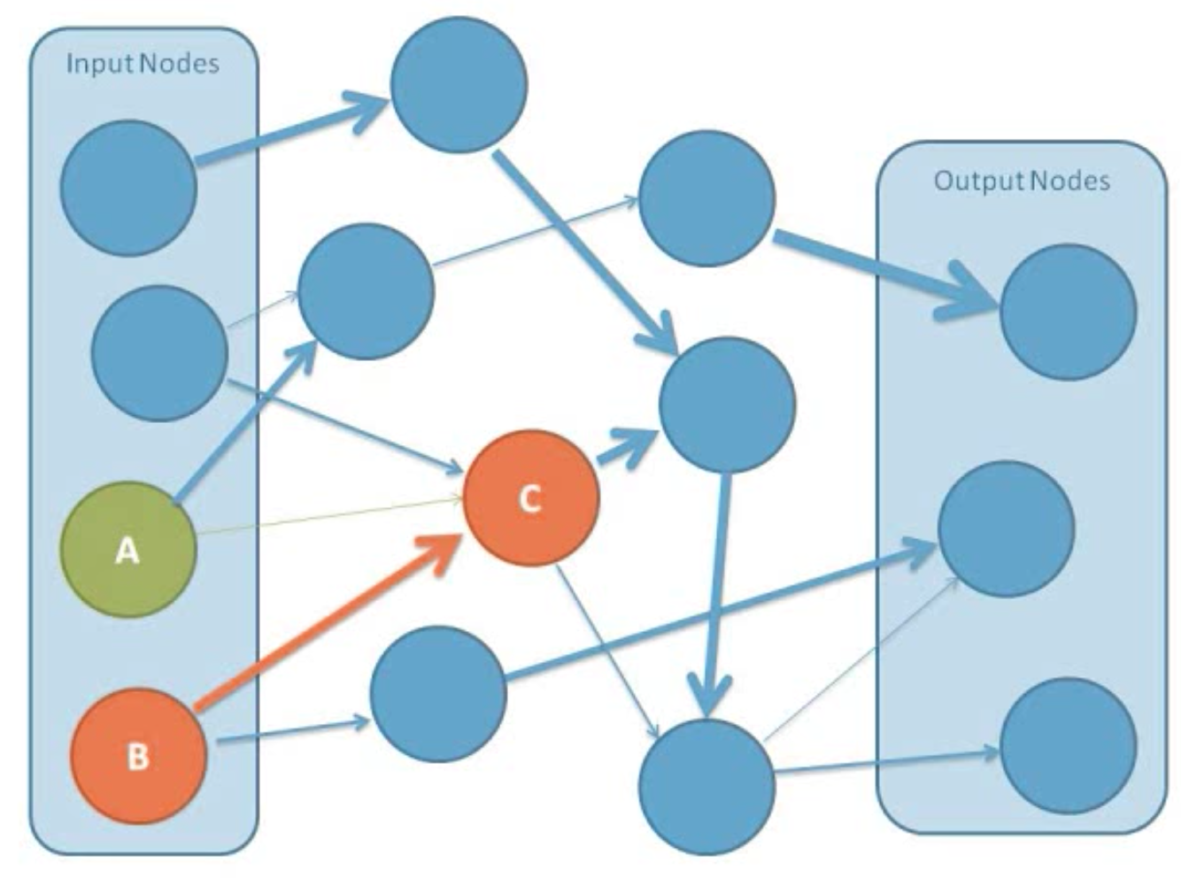
Connections have different weights
Notes:
Even though each neuron is connected to all the neurons in the layers before and after it, the weights make it so that only certain nodes have a significant effect.
From “Intro to Neural Networks” youtube video by Jesus Suarez
https://www.youtube.com/watch?v=DG5-UyRBQD4

Slide 20
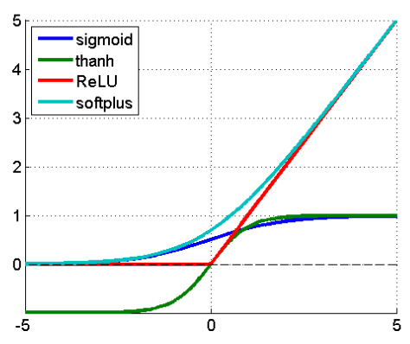
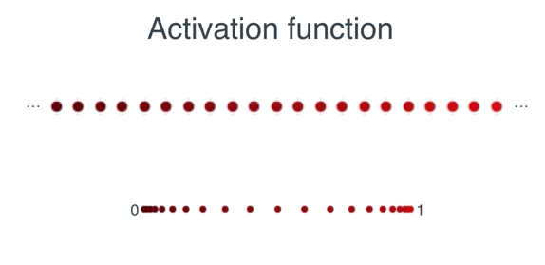
Input is judged using an activation function
Activation or transfer function
Nonlinear
Rectified Linear Unit (ReLU)
Notes:
The activation function determines how each node output is affected by the various inputs.
A node can effectively decide whether to accept an input or not
Most deep networks use ReLU - max(0,x) - nowadays for hidden layers, since it trains much faster, is more expressive than logistic function and prevents the gradient vanishing problem.

Slide 21
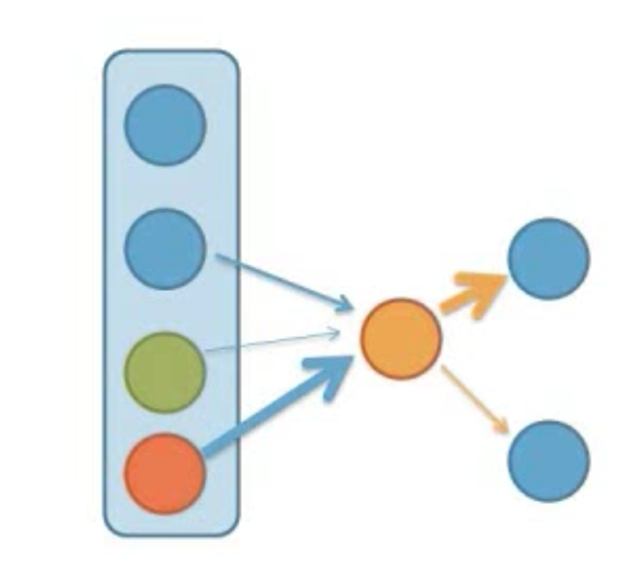
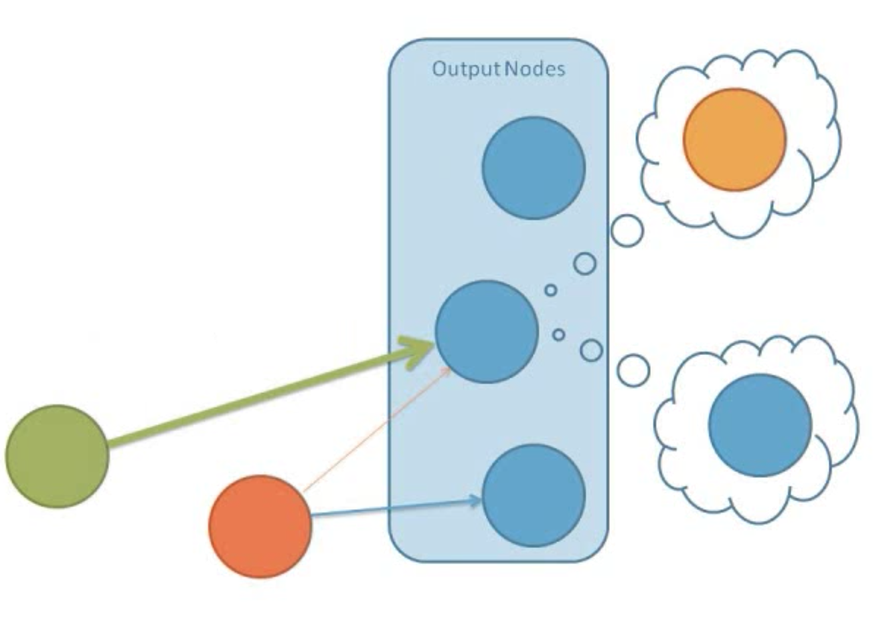
Node sets its value, triggers next node

Slide 22
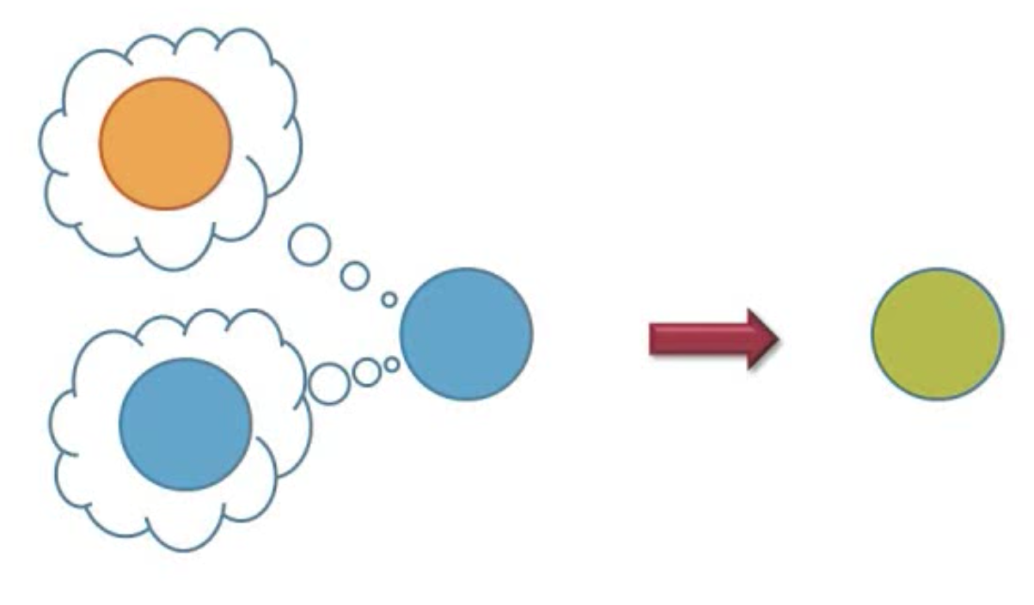
New value = old value + input

Slide 23
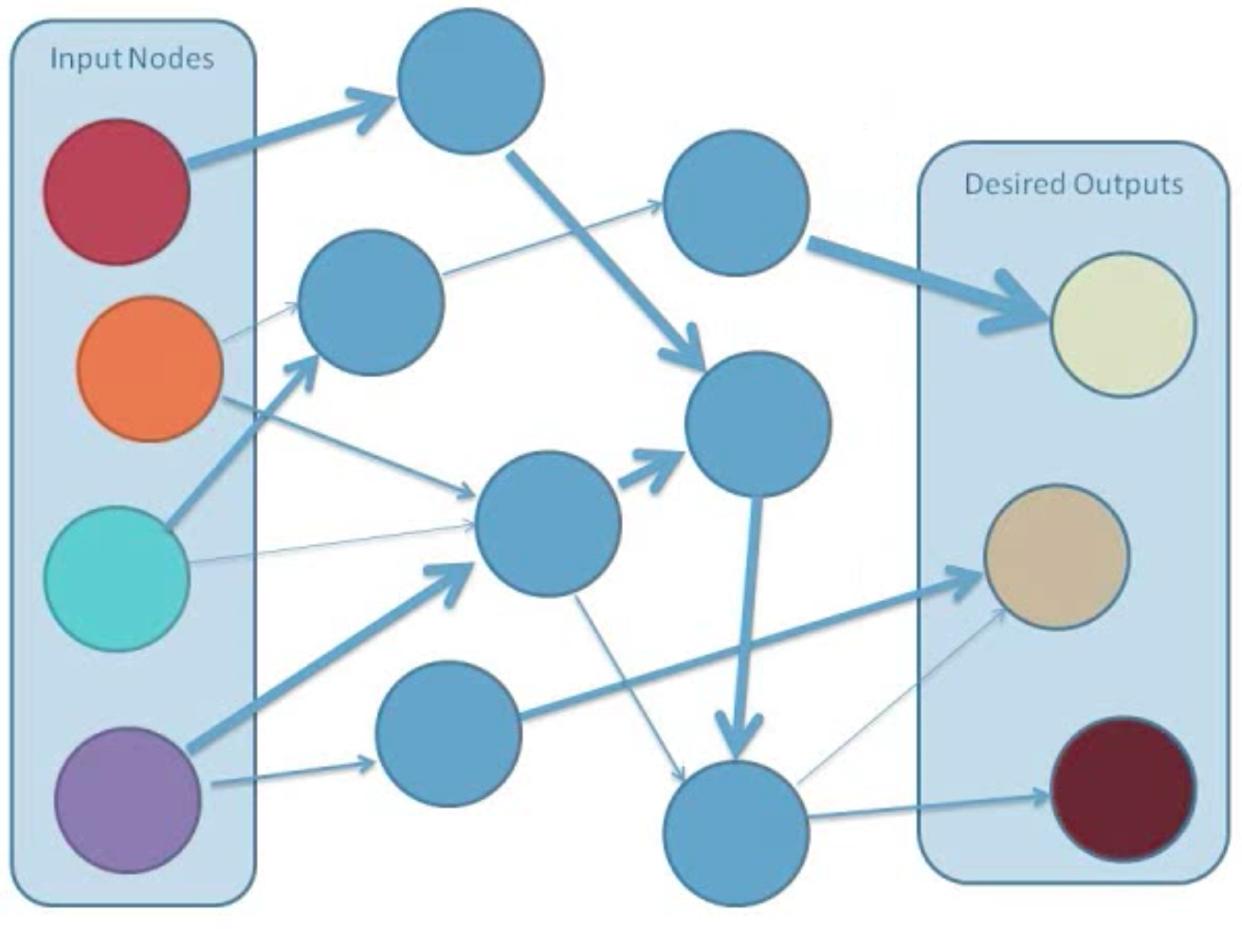
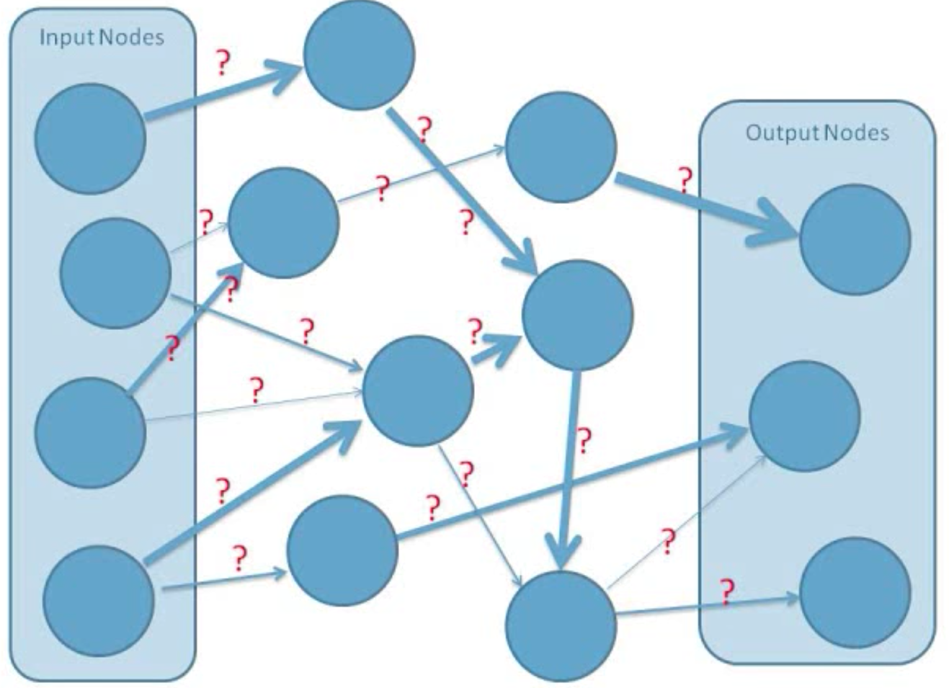
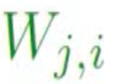
Backpropagation
The process to learn the correct weights
Start with random weights

Slide 24
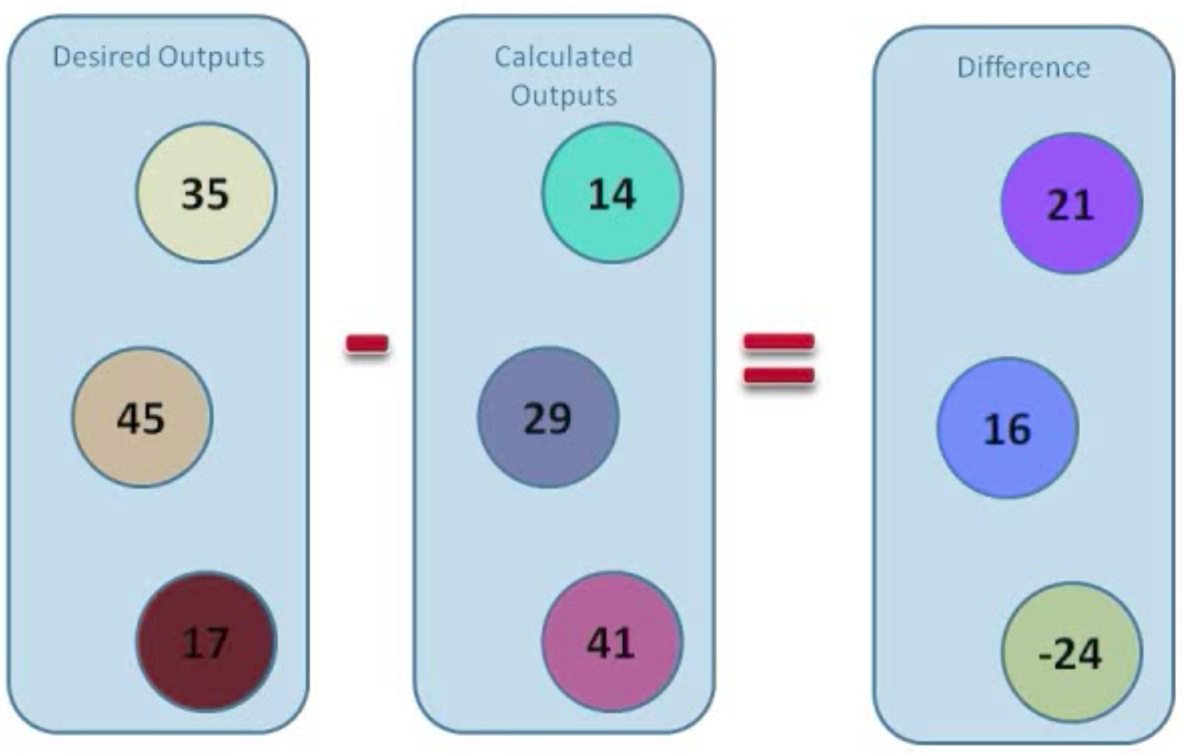
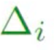
Error in the network

Slide 25
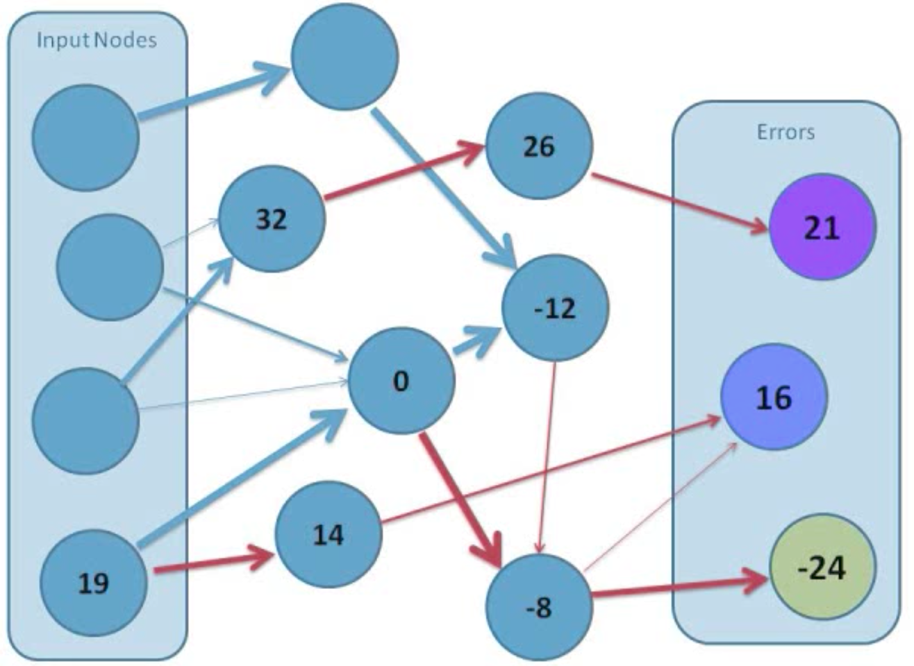
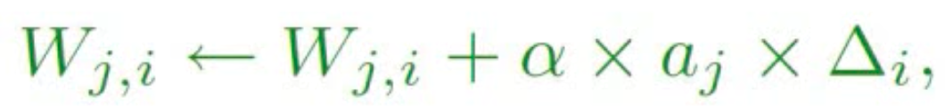
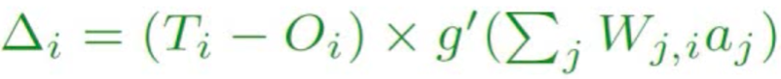
Adjust the connection weights
Improved connection weights W_{j,i}
compared to the random ones
Improved node values a_{j} and improved errors

Slide 26
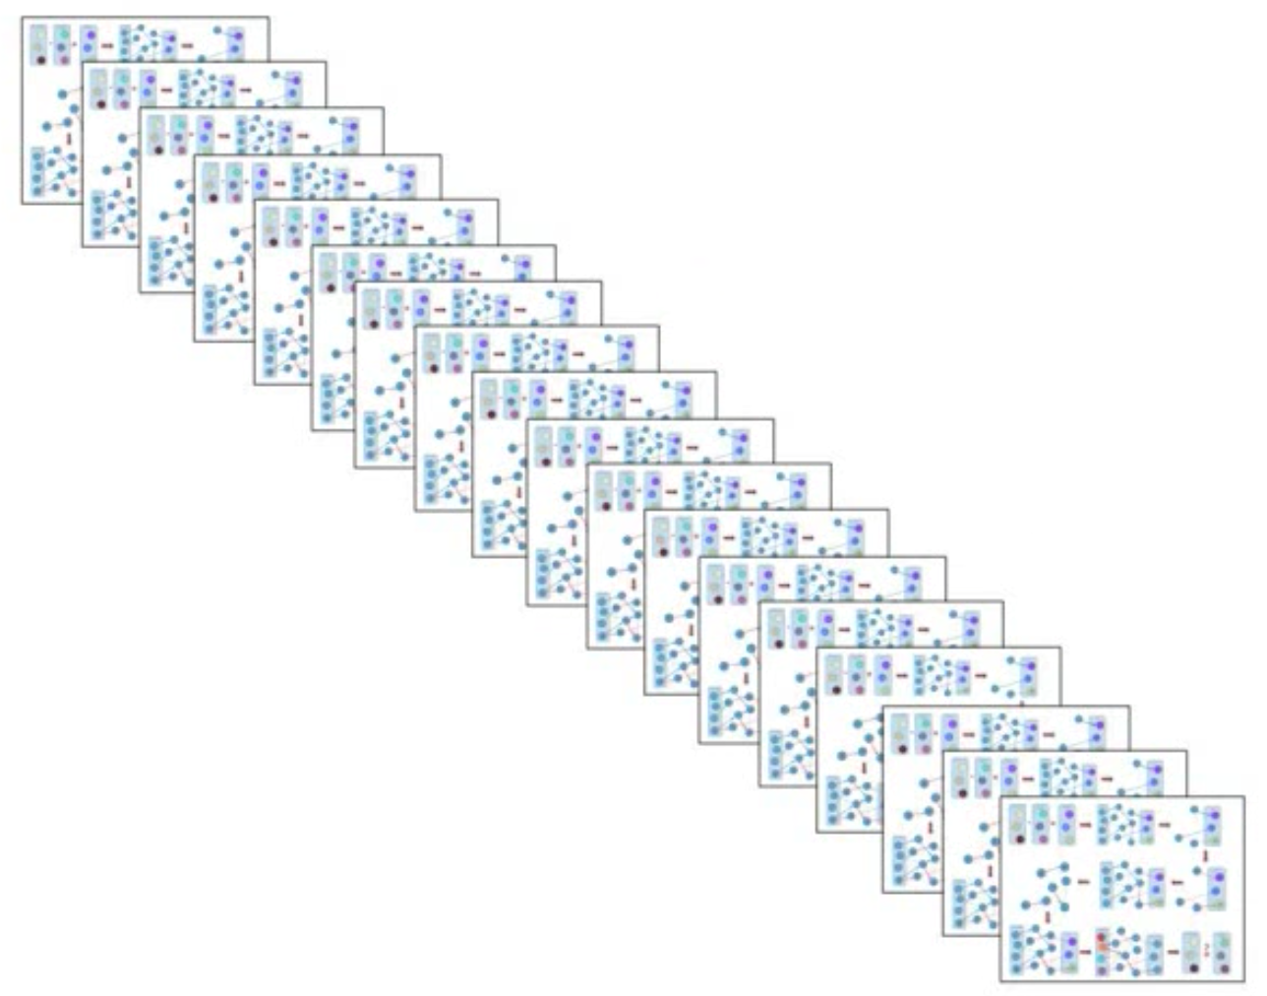
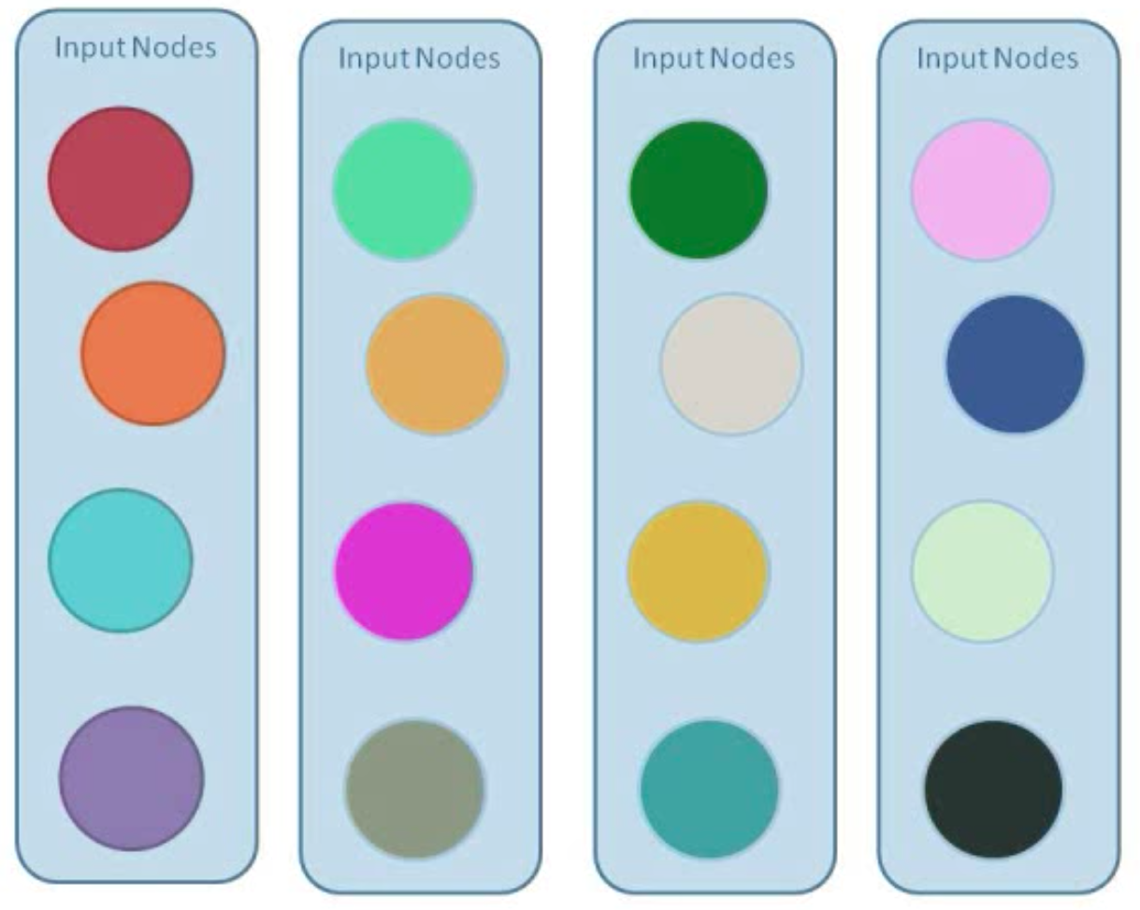
Repeated for each input set
Notes:
Each digit, each sample of digits

Slide 27
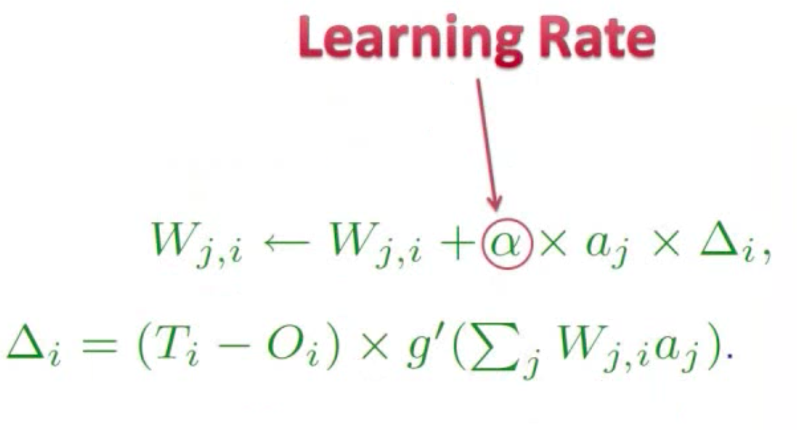
Learning Rate
Notes:
Each digit, each sample of digits

Slide 28
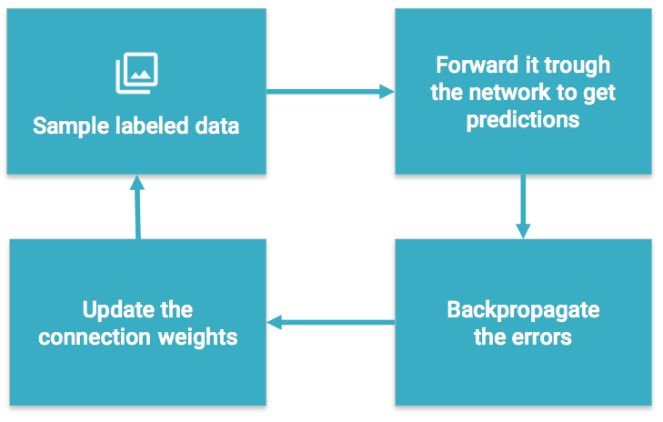
Training a Neural Network
Notes:
Learns by generating an error signal that measures the difference between the predictions of the network and the desired values and then using this error signal to change the weights (or parameters) so that predictions get more accurate.

Slide 29
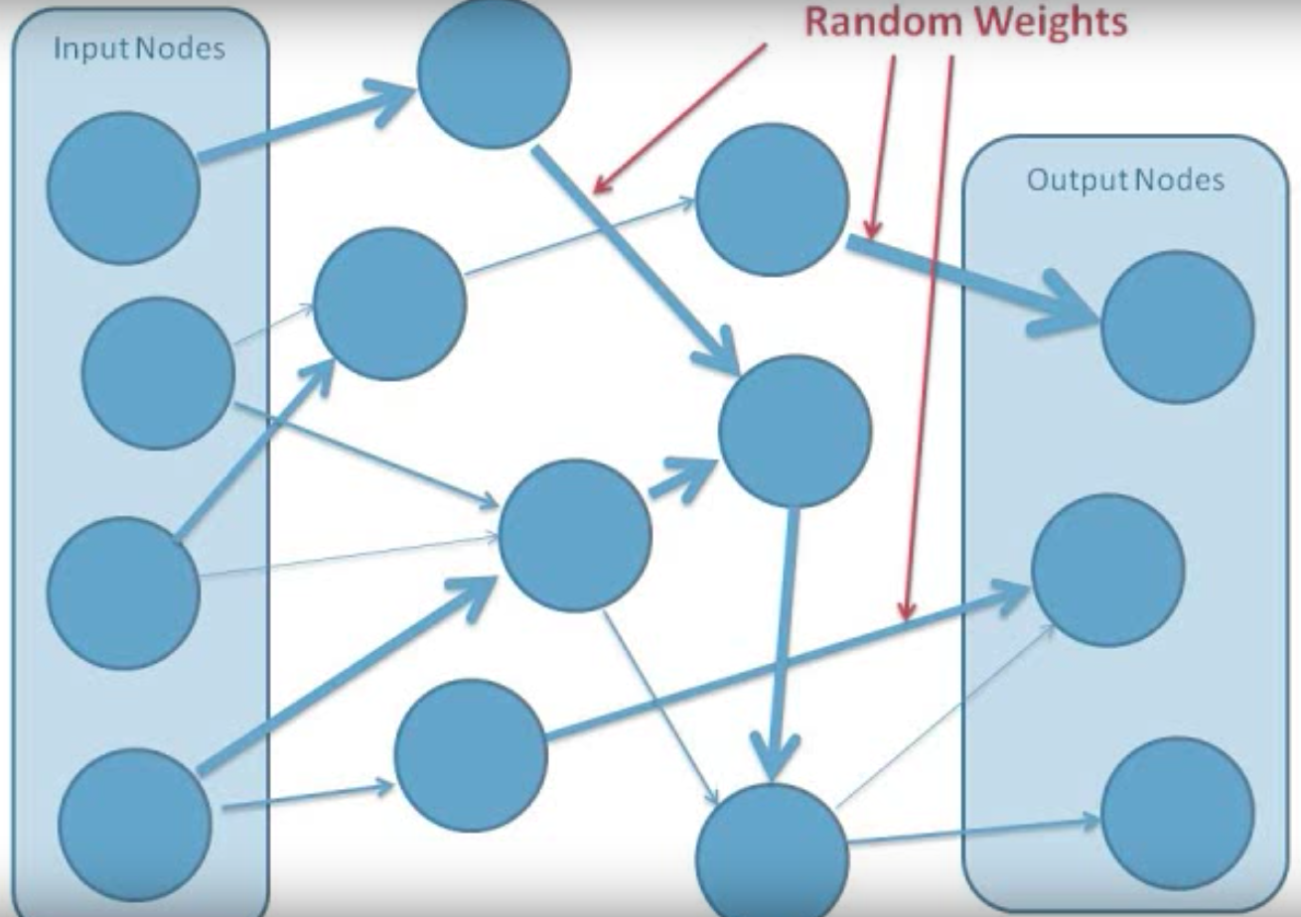
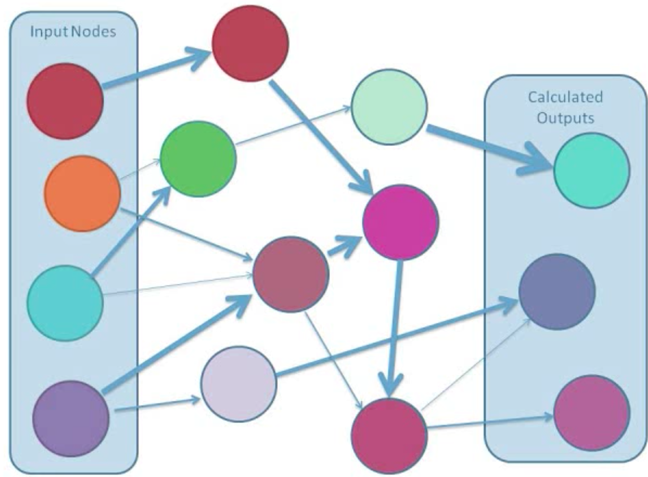
Determining connection weights
Notes:
Start giving connections random weights,
Give input and calculate outputs based on the random weights.

Slide 30

Gradient Descent
Find the minimum of the cost function
Use that to adjust the weights
Notes:
Gradient Descent finds the (local) the minimum of the cost function (used to calculate the output error) and is used to adjust the weights.

Slide 31
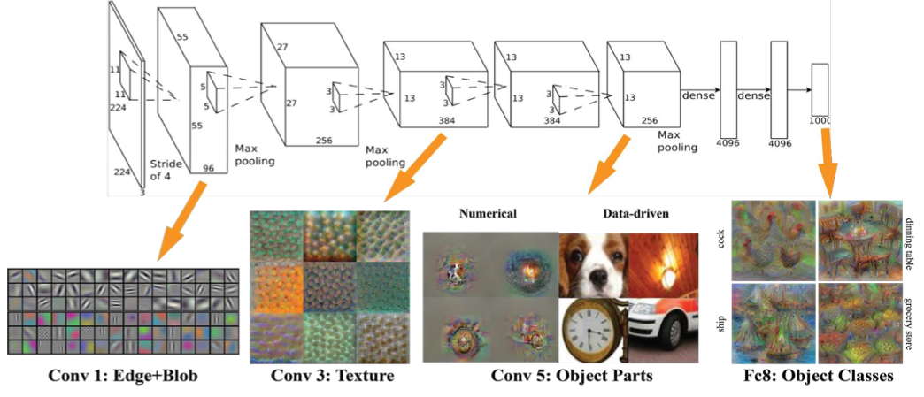
Convolution Layer – filter unnecessary
Notes:
Convolution layer is a feature detector that learns to filter out unnecessary information from an input by using convolution kernel

Slide 32
Pooling Layer – max or average
Notes:
Pooling layers compute the max or average value of a particular feature over a region of the input data (downsizing of input images). Also helps to detect objects in some unusual places and reduces memory size.

Slide 33
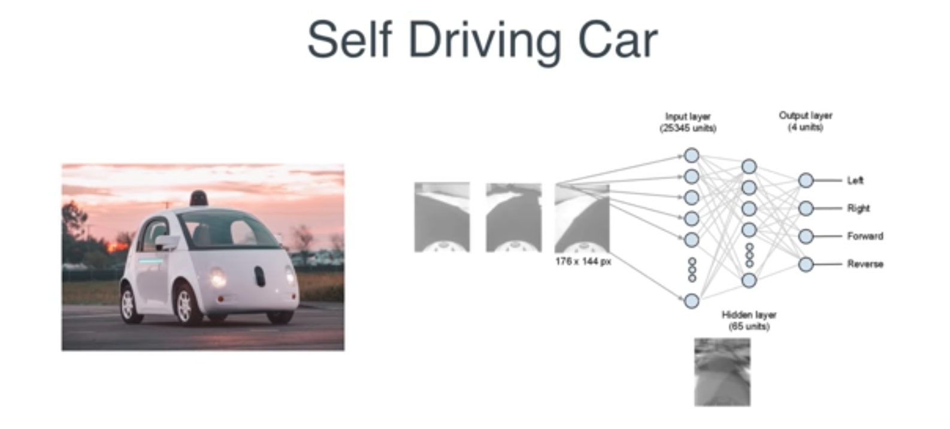
Example

Slide 34
Requirements
Lots of labeled data of high quality
Measurable goals and cost function
Lots of computing power

Slide 35
Challenges
Training on less data
Natural Language Processing
Understanding videos
Deep reinforcement
Unsupervised learning
Quantum computing

Slide 36
Summary
Deep Learning
Deep Neural Networks
Examples
Hidden layers
Backpropagation
Weights
Errors
Learning coefficients
Requirements
Gradient descent
Convolutional Neural Networks

Slide 37
Correlation does not imply causation

Slide 38
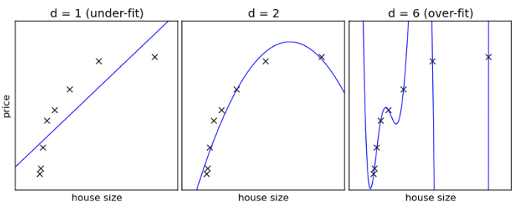
Biases and common mistakes
Underfitting Overfitting
Notes:
Overfitting, Occam’s razor, simplest hypothesis appropriate but no simpler.
won’t generalize well to unseen data
Memorizing instead of learning.
Taking a random effect as an actual correlation/trend
Data Leakage- you use data that includes some aspects of what you’re trying to predict.
Sampling Bias (cherry-picking)
https://medium.com/machine-intelligence-report/new-to-machine-learning-avoid-these-three-mistakes-73258b3848a4
Cardinal sins, minefield

Slide 39
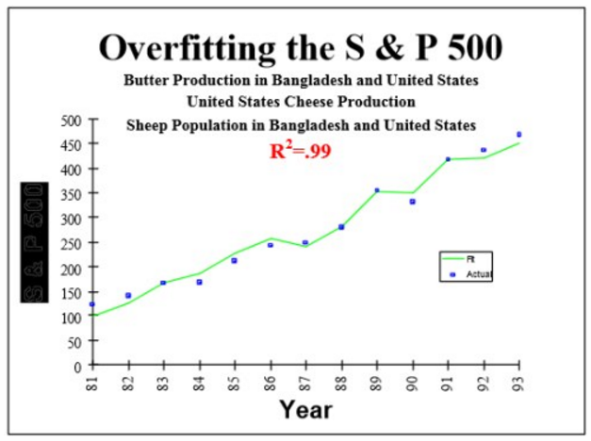
Overfitting
Notes:
• The researchers test too many hypotheses without proper statistical control, until they happen to find something interesting and report it. Not surprisingly, next time the effect, which was (at least partly) due to chance, will be much smaller or absent.
Several methods can be used to avoid "overfitting" the data
Try to find the simplest possible hypothesis
Regularization (adding a penalty for complexity)
Randomization Testing (randomize the class variable, try your method on this data - if it find the same strong results, something is wrong)
Nested cross-validation (do feature selection on one level, then run entire method in cross-validation on outer level)
Adjusting the False Discovery Rate

Slide 40
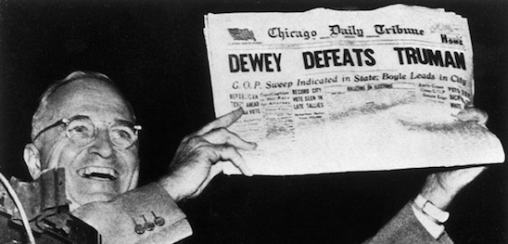
Sampling Bias
Notes:
This calls to mind the 1948 US presidential election, in which polls (and pundits) predicted a landslide for Republican Thomas E. Dewey, but Harry Truman won handily. The widely accepted explanation: fewer Democratic-inclined voters owned telephones.
The classic example of sampling bias is the ‘Dewey Defeats Truman’ headline, from the Chicago Tribune in 1948. The newspaper got their prediction wrong because they sampled people with telephones, at a time when telephones were comparatively rare. Most of the people who had them were rich, and rich people were more supportive of Dewey. As a consequence, telephone polling provided bad information about the likely voting behaviour of the whole population.

Slide 41
Notes:
ecological fallacy (assigning patterns to observed for the group at the individual level, also known as confusion of the inverse)

Slide 42
Notes:
multiple testing error

